Slide 1
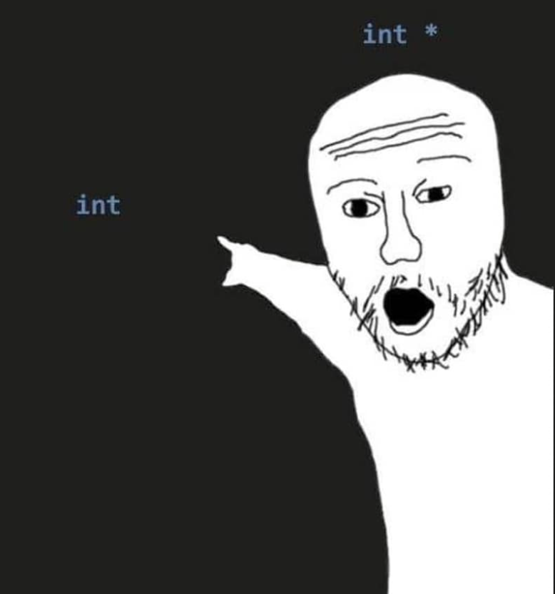
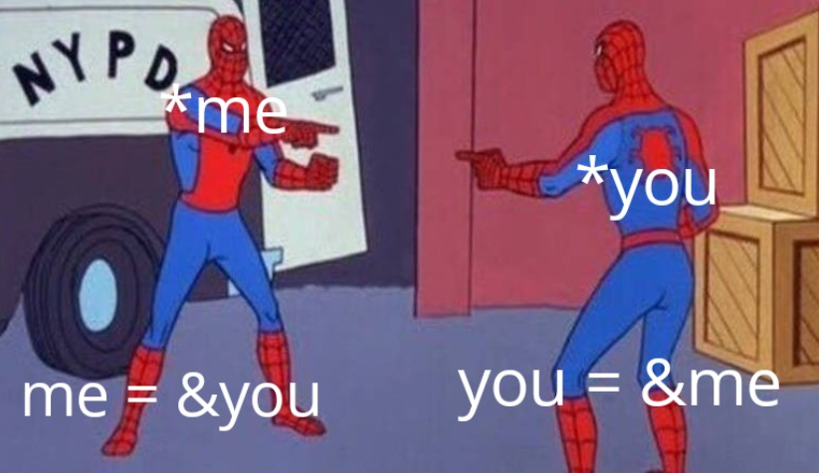
POINTERS
Sumaiyah Zahid

Slide 2

Address Space
Name = FAST
Value / Occupants = Students
Address = St-4, Sector 17-D، National Hwy 5, Karachi

Slide 3
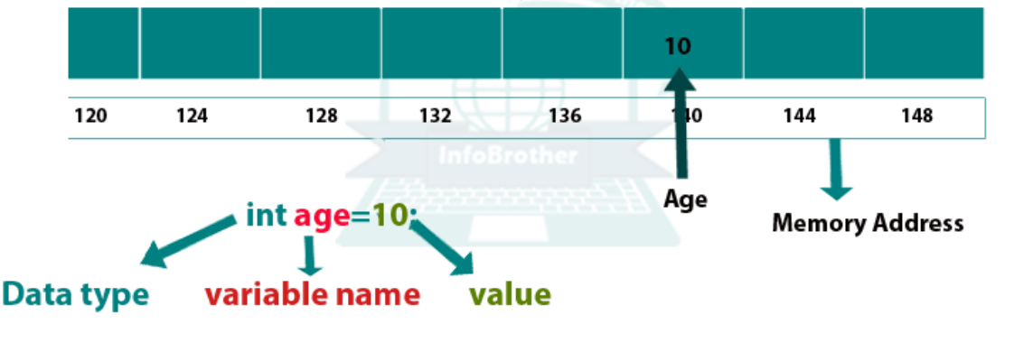
Address Space
int x = 10;
Name = x
Value = 10
Address = Any memory location
You can access that memory location using & operator.

Slide 4
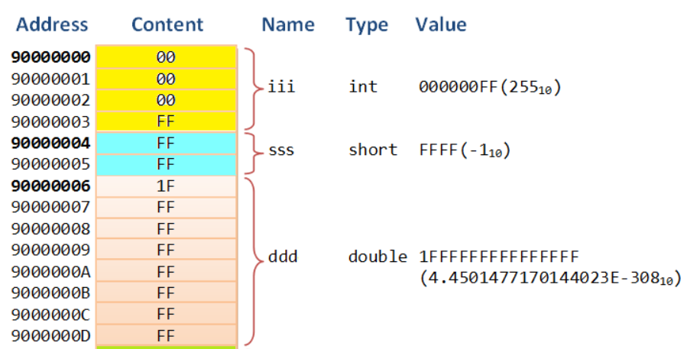
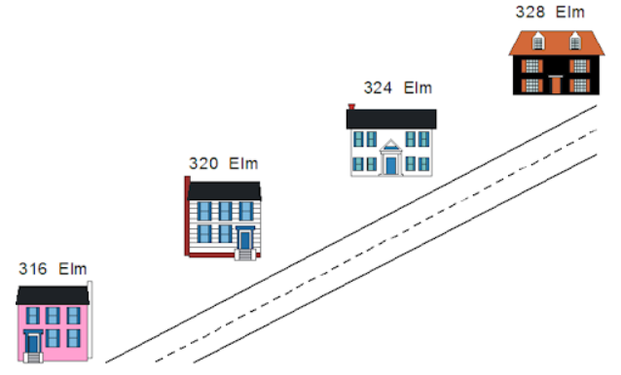
Address Space
Like houses, each variable has a unique address that gets larger as you move along the street or through memory.
The contents of a variable, like the occupants of a house, can change over time, but the address of a variable, like the address of a house, is fixed and does not change (unless the house is picked up by a tornado and carried over a rainbow, which almost never happens).

Slide 5
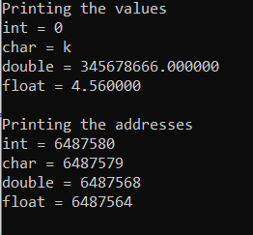
#include <stdio.h>
int main()
{
int a=0;
char b='k';
double c=345678666;
float d=4.56;
printf("Printing the values\n");
printf("int = %d\nchar = %c\ndouble = %lf\nfloat = %f\n",a,b,c,d);
printf("Printing the addresses\n");
printf("int = %d\nchar = %d\ndouble = %d\nfloat = %d \n", &a, &b, &c, &d);
return 0;
}

Slide 6
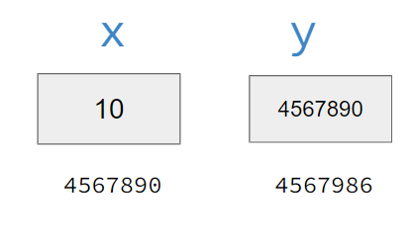
POINTERS DEFINITION
To hold any address of variable, computer needs another storage location.
Pointer is a variable which holds address of another variable.
int x = 10;
int *y = &x;

Slide 7
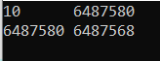
POINTERS DEFINITION
& Address Operator
* Dereferencing Operator
int x = 10;
int *y = &x; or int *y; y = &x;
printf("%d %d\n",x,y);
printf("%d %d\n", &x, &y);

Slide 8
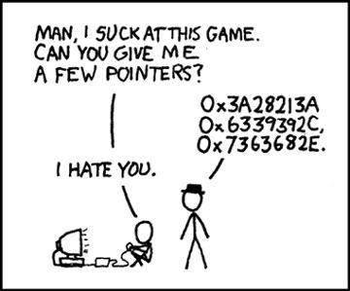
POINTERS DEFINITION
Interestingly we can access value of x through y variable too.
y = holds the address of x
*y = pointer accessing value
of x
printf("%d %d\n",y,*y);

Slide 9
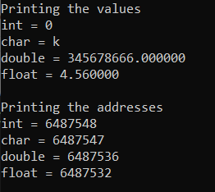
#include <stdio.h>
int main()
{
int a=0; int *ap;
char b='k'; char *bp;
double c=345678666;double *cp;
float d=4.56; float *dp;
ap = &a; bp = &b; cp = &c; dp=&d;
printf("Printing the values\n");
printf("int = %d\nchar = %c\ndouble = %lf\nfloat = %f\n", *ap, *bp, *cp, *dp);
printf("Printing the addresses\n");
printf("int = %d\nchar = %d\ndouble = %d\nfloat = %d \n", ap, bp, cp, dp);
return 0;
}

Slide 10
#include <stdio.h>
int main()
{
int fno, sno, *ptr, *qtr, sum;
printf(" Input the first number : ");
scanf("%d", &fno);
printf(" Input the second number : ");
scanf("%d", &sno);
ptr = &fno;
qtr = &sno;
sum = *ptr + *qtr;
printf(" The sum of the entered numbers is : %d\n\n",sum);
return 0;
}

Slide 11
Why POinters?
Increases the execution speed of program.
Used for dynamic memory allocation.
Pass by reference.
Pointers makes possible to return more than one value in functions.
To access variables that are declared outside the functions.
Strings and arrays are more efficient with pointers.

Slide 12
Practise Exercise
The length & breadth of a rectangle and radius of a circle are input through the keyboard. Write a program to calculate the area & perimeter of the rectangle, and the area & circumference of the circle using pointers.
Write a program that asks the user to enter two numbers, obtains them from the user and prints their sum, product, difference, quotient and remainder using pointers.

Slide 13
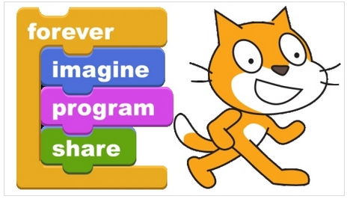
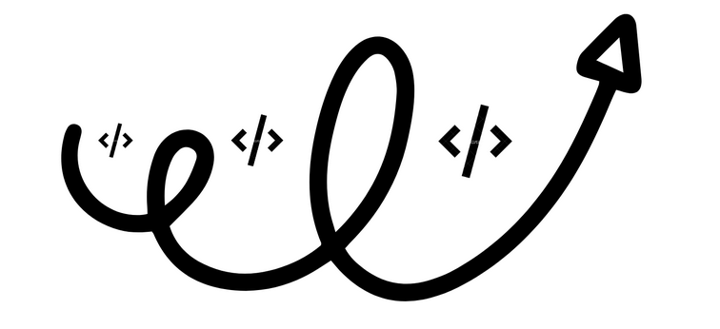
Loopy Loop
Week 3
Sumaiyah Zahid

Slide 14
Loop World
Start
Eat
Sleep
Code
Go to Line 2
End
The real power of computers is in their ability to repeat
an operation or a series of operations many times.
When action is repeated many times, the flow is called a
loop.

Slide 15
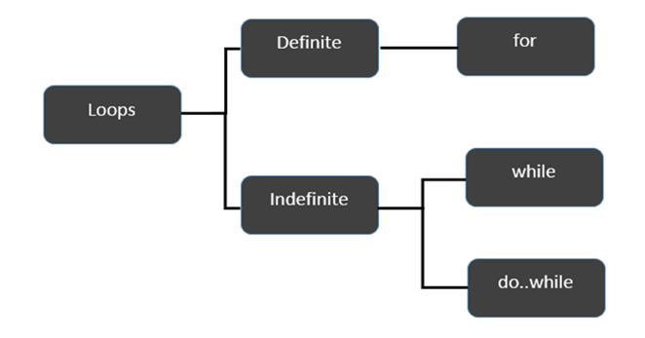
Loop Logic Structure

Slide 16
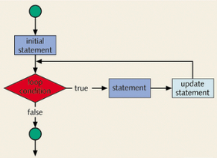
FOR Loop
for(initial statement; loop condition; update statement)

Slide 17
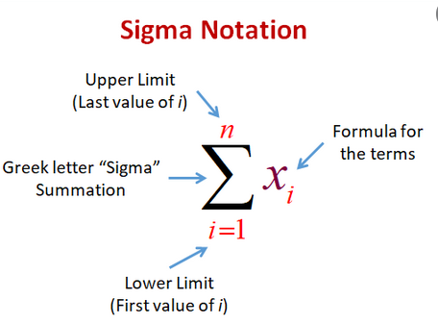
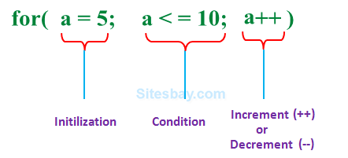
FOR LOOP

Slide 18
For Loop Execution
The for loop executes as follows:
The initial statement executes.
The loop condition is evaluated. If the loop condition evaluates to true
Execute the for loop statement.
Execute the update statement.
Repeat Step 2 until the loop condition evaluates to false.
The initial statement usually initializes a variable is the first statement to be executed and is executed only once.

Slide 19
#include <stdio.h>
int main()
{
int i;
for (i=0; i<5; i++)
{
printf("Hello World\n");
}
return 0;
}
}

Slide 20
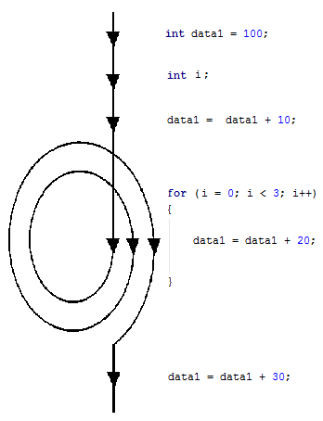

Slide 21
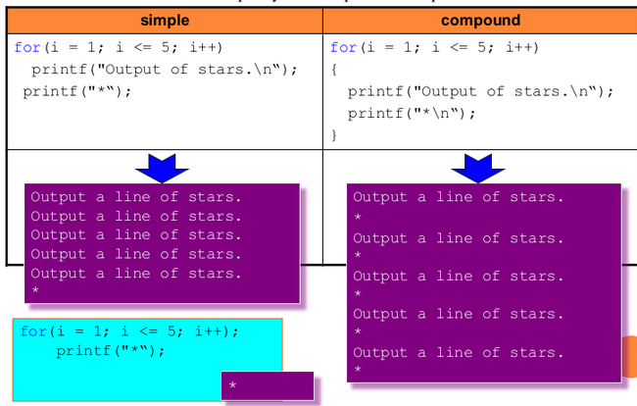

Slide 22
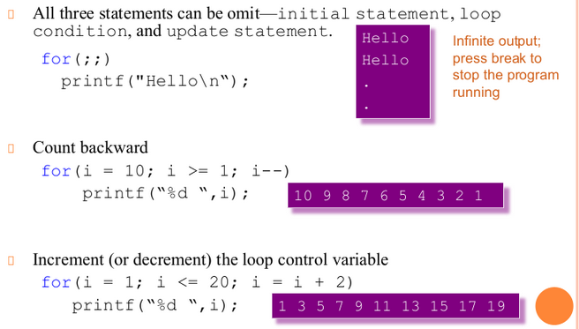

Slide 23
Suppose we want to add five numbers (say to find their average).
From what you have learned so far, you could proceed as follows.
scanf(%d %d %d %d %d,&num1,&num2,&num3,&num4,&num5);
sum = num1+num2+num3+num4+num5;
average = sum/5;
Suppose we wanted to add and average 100, or 1000, or more numbers. We would have to declare that many variables, and list them again in scanf statement, and perhaps, again in the output statement.

Slide 24
#include <stdio.h>
int main()
{
int sum=0,i, new_num,avg;
for (i=0; i<5; i++)
{
printf("Enter Number ");
scanf("%d",&new_num);
sum=sum+new_num;
}
avg=sum/5;
printf("The Sum is %d \n",sum);
printf("The Average is %d \n", avg);
return 0;
}

Slide 25
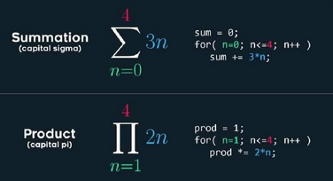

Slide 26
Home Exercise
Using for loop print a multiplication table of any user given number.
Input integer: 2
2*1=2
2*2=4
2*3=6
...

Slide 27
Home Exercise
Write a program in C to display the cube of the number upto given an integer.
Input number of terms : 5
Expected Output :
Number is : 1 and cube of the 1 is :1
Number is : 2 and cube of the 2 is :8
Number is : 3 and cube of the 3 is :27
Number is : 4 and cube of the 4 is :64
Number is : 5 and cube of the 5 is :125

Slide 28
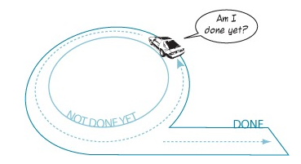
While Loop
Also known as conditional loop.
while (not succeed)
{
keep_trying();
}

Slide 29
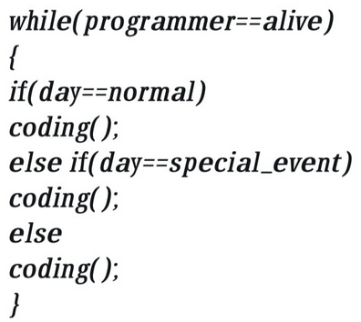
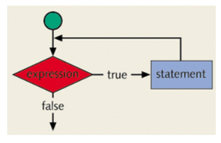
While Loop

Slide 30
#include <stdio.h>
int main()
{
int i=0;
while (i<5)
{
i++;
printf("Hello World\n");
}
return 0;
}
}

Slide 31
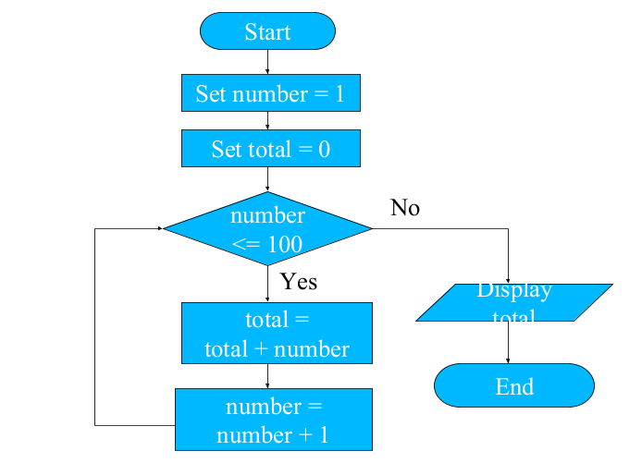
PRactice Question
Make a C program using while loop which calculates the sum of 100 integers 1, 2, 3, …, 100.

Slide 32
#include <stdio.h>
int main()
{
int i=0, sum=0;
while (i<100)
{
i++;
sum=sum+i;
}
printf("The Sum is %d.",sum);
return 0;
}

Slide 33
Practice Question
Make a C program using while loop which calculates the sum of n integers until sum is less than 100.

Slide 34
#include <stdio.h>
int main()
{
int i=0, sum=0;
while (sum<=100)
{
i++;
sum=sum+i;
}
printf("The Sum is %d.",sum);
return 0;
}

Slide 35
Practice Question
Make a C program to convert decimal number to binary.

Slide 36
#include <stdio.h>
int main()
{
int num,a;
printf("Enter decimal number :");
scanf("%d", &num);
while (num!=0)
{
a=num%2;
printf("%d",a);
num=num/2;
}
return 0;
}

Slide 37
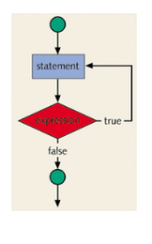
Do- While Loop
do
{
keep_trying();
}
while (not succeed);

Slide 38
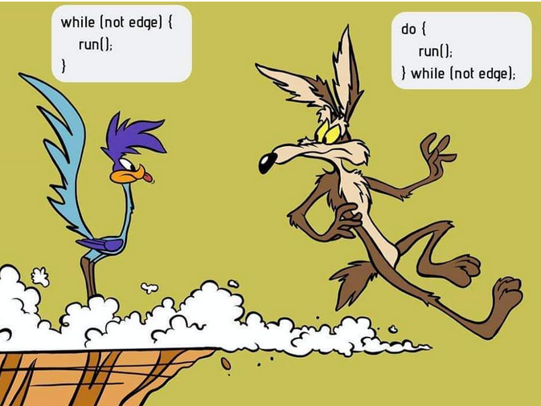

Slide 39

What’s the Output?
i = 11;
while(i <= 10)
{
printf(“%d “,i);
i++;
}
i = 11;
do
{
printf(“%d “,i);
i++;
}
while(i <= 10);

Slide 40
Practice Question
Write a C program using do while to keep asking for a number until you enter a +ve number.

Slide 41
#include <stdio.h>
int main()
{
int num;
do
{
printf("Enter any number :");
scanf("%d", &num);
}
while (num < 0);
return 0;
}

Slide 42
Practice Question
Make a C program which ask the user for the password until it matches with the actual one.
Make a C program which ask the user for the password. If it doesn’t match in 3 trials, it shouldn't ask again.

Slide 43
Home Assignment
Make a C program to print first 50 even numbers.
Make a C program to read an age of 15 person & find out how many of them fall under :
a) Still a baby- age 0 to 5
b) Attending school - age 6 to 17
c) Adult life-age 18 & over

Slide 44
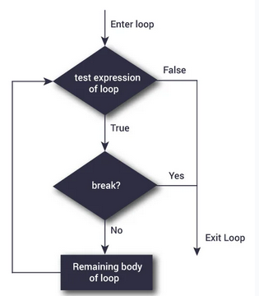
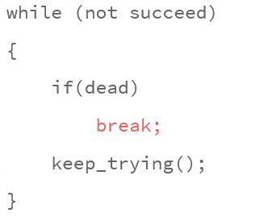
Break
You can use the break statement in while, for, and do...while loops to alter the flow of control.
When the break statement executes in a repetition structure, it immediately exits from these structures.

Slide 45
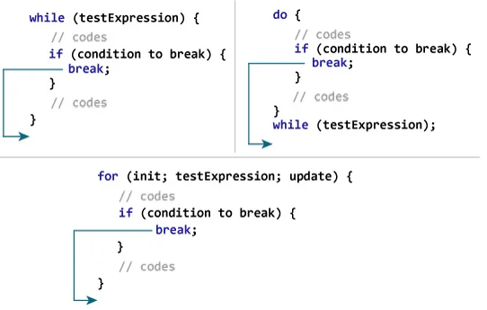
Break

Slide 46
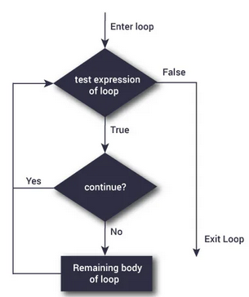
Continue
The continue statement is used in while, for, and do-while structures.
When the continue statement is executed in a loop, it skips the remaining statements and proceeds with the next iteration of the loop.
In a while and do-while structure, the expression (that is, the loop-continue test) is evaluated immediately after the continue statement.
In a for structure, the update statement is executed after the continue statement, and then the loop condition (that is, the loop-continue test) executes.

Slide 47
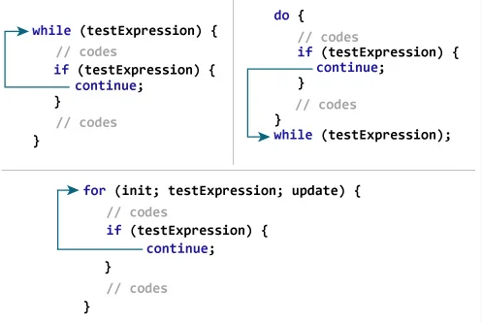
COntinue

Slide 48
Can you print this using for loop?
1
2
3
4
5

Slide 49
Can you print this using for loop?
1
2
3
4
5
for( i=1; i<=5; i++)
{
printf(“%d \n”, i);
}

Slide 50
Can you print this using for loop?
1 2 3 4 5

Slide 51
Can you print this using for loop?
1 2 3 4 5
for( i=1; i<=5; i++)
{
printf(“%d ”, i);
}

Slide 52
Can you print this using for loop?
1 2 3 4 5
1 2 3 4 5

Slide 53
Can you print this using for loop?
1 2 3 4 5
1 2 3 4 5
for( i=1; i<=5; i++)
{ printf(“%d ”, i);}
printf (“\n”);
for( i=1; i<=5; i++)
{ printf(“%d ”, i);}

Slide 54
Can you print this using for loop?
1 2 3 4 5
1 2 3 4 5
1 2 3 4 5
1 2 3 4 5
1 2 3 4 5

Slide 55
Can you print this using for loop?
for( i=1; i<=5; i++)
printf(“%d ”, i);
printf (“\n”);
for( i=1; i<=5; i++)
printf(“%d ”, i);
printf (“\n”);
for( i=1; i<=5; i++)
printf(“%d ”, i);
printf (“\n”);
for( i=1; i<=5; i++)
printf(“%d ”, i);
printf (“\n”);

Slide 56
It’s a for of For Loop
for( j=1; j<=5; j++)
{
for( i=1; i<=5; i++)
printf(“%d ”, i);
printf (“\n”);
}

Slide 57
Can you print this using NESTED for loop?
row=1 1
row=2 1 2
row=3 1 2 3
Row=4 1 2 3 4
row=5 1 2 3 4 5

Slide 58
It’s a for of For Loop
for( j=1; j<=5; j++)
{
for( i=1; i<=j; i++)
printf(“%d ”, i);
printf (“\n”);
}

Slide 59
Can you print this using NESTED for loop?
1 2 3 4 5
1 2 3 4
1 2 3
1 2
1

Slide 60
It’s a for of For Loop
for( j=1; j<=5; j++)
{
for( i=1; i<=6-j; i++)
printf(“%d ”, i);
printf (“\n”);
}

Slide 61
Home Assignment
1
1 2
1 2 3
1 2 3 4
1 2 3 4 5
1 2 3 4
1 2 3
1 2
1

Slide 62
Can you print this using NESTED for loop?
1
1 2
1 2 3 5-i
1 2 3 4
1 2 3 4 5

Slide 63
It’s a for of For Loop
for( j=1; j<=5; j++)
{
for( i=1; i<=5-j; i++)
printf(“ ”, i);
for( i=1; i<=j; i++)
printf(“%d”, i);
printf (“\n”);
}

Slide 64
Nested Loops
while(condition) {
printf(“Outer loop”);
while(condition)
{
printf(“Inner Loop”);
}
printf(“Outer loop”);
}

Slide 65
Can you print this using NESTED WHILE loop?
1
1 2
1 2 3
1 2 3 4
1 2 3 4 5

Slide 66
Nested While
int i=1,j;
while(i<6)
{
j=1;
while(j<i)
{
printf("%d",j);
j++;
}
printf("\n");
i++;
}

Slide 67
Can you print this using NESTED WHILE loop?
1
1 2
1 2 3
1 2 3 4
1 2 3 4 5

Slide 68
Nested While
int i=1,j; // Main Loop
while(i<6) // Outer Loop
{
j=1;
while(j<6-i) // Inside loop 1
{
printf(" ");
j++;
}
j=1;
while(j<i) // Inside Loop 2
{
printf("%d ",j);
j++;
}
printf("\n"); // Outer Loop
i++;
}

Slide 69
Can you print this using NESTED WHILE loop?
1 2(i) + 1 // 2(i)-1
123
12345
1234567
123456789

Slide 70
Nested While
int i=1,j; // Main Loop
while(i<6) // Outer Loop
{
j=1;
while(j<6-i) // Inside loop 1
{
printf(" ");
j++;
}
j=1;
while(j<=2*i-1) // Inside Loop 2
{
printf("%d",j);
j++;
}
printf("\n"); // Outer Loop
i++;
}

Slide 71
Nested Loops
do {
printf(“Outer loop”);
do
{
printf(“Inner Loop”);
} while(condition);
printf(“Outer loop”);
} while(condition);

